Slide 1

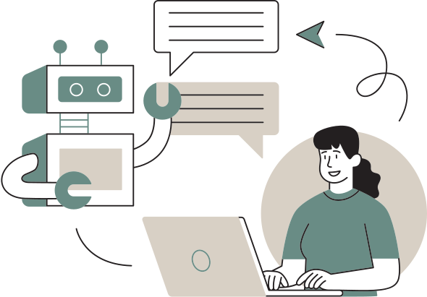




Mental Health Care Bot
Presentation By:
1. Vidisha Khandale [ Team Leader ]
2. Akshata Gedam
3. Atharva Bhamkar
4. Aayush Kelwadkar
Guide: Prof. Sonal Nimbalkar
Date: Sept 05, 2024

Slide 2




Introduction
Uses AI and machine learning to offer real-time, personalized mental health guidance for stress, anxiety, and depression.
Available 24/7 with multilingual support for a broader audience.
Engages users in real-time conversations with personalized advice based on individual emotional states.
Offers valuable mental health information, advice, and self-care tips to enhance users' understanding and awareness of their mental well-being.
Delivers mental health resources in a non-judgmental environment, encouraging open discussions.
Ensures user privacy but is not a replacement for professional therapy.
Aims to enhance emotion recognition, dialogue depth, and service integration.

Slide 3

Objectives
01
02
03
Understanding Chatbot Potential
Identifying Motivating Factors
Addressing Research Gaps
Examine how chatbots can transform consumer interactions with data and services
Explore the motivating elements that influence why people use chatbots.
Address the current gap in empirical research regarding why people use chatbots.
04
05
Guiding Future Research
Chatbot Design and Development
Provide insights that can guide future studies and research in the field of chatbots.
Offer findings that could aid in designing and developing more effective chatbots in the future.

Slide 4
Literature Review
Development of a virtual mental health assistant to address cost, time, and resource limitations in traditional counseling.
Multilingual text input, mood improvement recommendations, and neural networks for response generation using NLP techniques.
Provide a free, accessible tool for mental health management.
Challenges:
Limited emotion recognition due to reliance on single modalities like text or voice.
Struggles with continuous emotional monitoring and ethical judgment.
User discomfort with machine interactions and reliance on clear inputs.
Limited scope, making it unsuitable for complex mental health issues requiring intensive therapy.

Slide 5

Methodology
These points provide a comprehensive overview of the process, focusing on the core aspects of data handling, model development, and user interaction in a mental health chatbot system.
Data Preparation | Load and preprocess ‘intents.json’ , tokenize, and lemmatize patterns to create a vocabulary and intent list.
Feature Extraction | Convert text to a binary "bag of words" model and use one-hot encoding for intents.
Model Creation | Build a Sequential model with Dense layers, using SGD optimizer and categorical cross-entropy loss, trained over 200 epochs.
Model Prediction | Tokenize and lemmatize user input, convert it to a bag of words, and predict the intent using the trained model.
Language Detection and Translation | Detect language with SpaCy, translate non-English inputs using Hugging Face, process, and translate responses back if needed.

Slide 6

Technologies, Libraries, and Algorithms
NLP Tools:
Data Handling:
NLTK (tokenization, lemmatization), SpaCy (language detection), Hugging Face Transformers (translation).
JSON (data parsing), Pickle (data saving/loading).
Deep Learning Tools:
Web Framework:
Keras (neural network), TensorFlow (backend), Sequential model, Dense layers, Dropout layers, SGD optimizer, categorical cross-entropy.
Flask (web interface).

Slide 7


System Architecture
Natural Language Understanding
Speech Recognition
Conversation Manager
Channel
Speech Synthesizer
User
Backend Integration
Backend Data Service

Slide 8
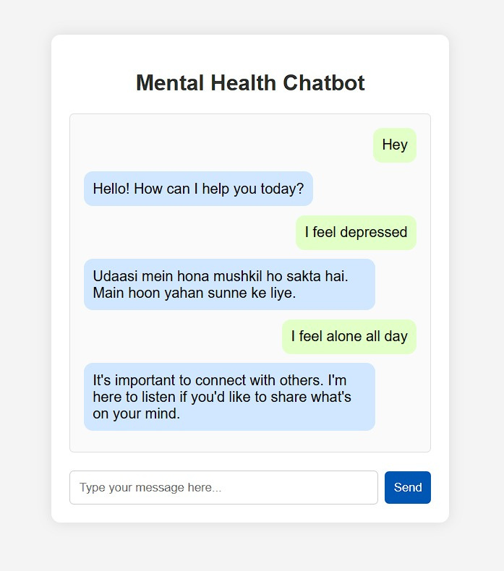
Completed Task & Current Status
Frontend Completed: The user interface for the chatbot is fully developed.
Basic Sentence Handling: Effectively manages and responds to basic user input.
Small Dataset Performance: Performs well with small datasets, giving expected outcomes.
Early-Stage Testing: Results are promising but may need further refinement.
Emotion Recognition: Ongoing work to improve understanding of nuanced emotional states.
Integration Testing: Preparing for integration with additional features or external systems.

Slide 9



Challenges Anticipated
Integration and Data Handling
Emotional and Ethical Considerations
Technology and Accuracy
Efficiently managing and integrating data from various sources, including user inputs and external databases, to ensure accurate and responsive interactions.
Addressing the emotional needs of users while maintaining ethical standards in responses, especially in sensitive mental health contexts.
Ensuring the chatbot's machine learning algorithms and natural language processing techniques are accurate and reliable in understanding and responding to diverse user queries.

Slide 10
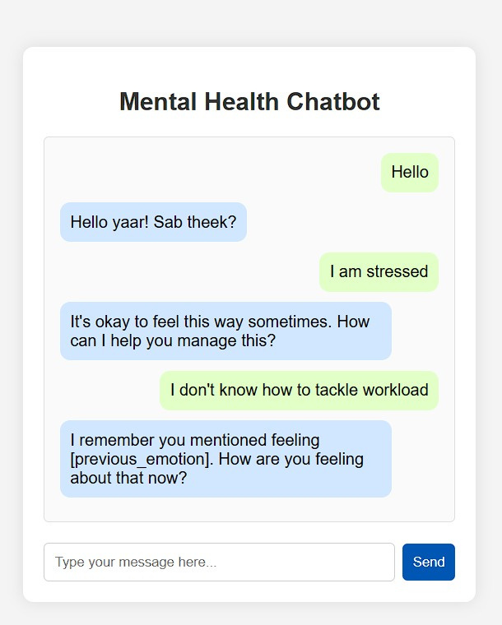
Future Work
Expand Dataset: Use larger, diverse datasets for better input handling.
Enhance NLP: Improve NLP for complex sentences and nuanced emotions.
Improve Emotion Recognition: Integrate advanced emotion detection.
Increase Personalization: Add features based on user history and preferences.
Continuous Learning: Enable learning from interactions to refine responses.
Expand Multilingual Support: Enhance language capabilities for accuracy.
Ethical and Privacy Enhancements: Strengthen data privacy and address ethical issues.

Slide 11

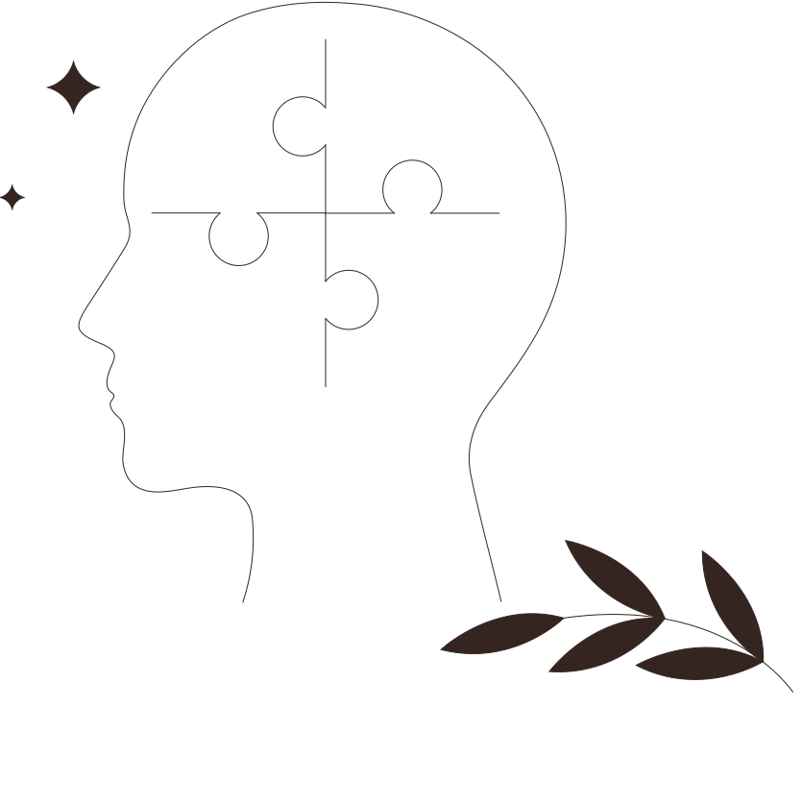
Expected Outcomes
Cost-Free Support: Always-available mental health care without cost barriers.
Engaging Features: Chat, multi-language support, and mood-boosting recommendations.
Mood Improvement: Understanding the inputs from user & providing human like response.
Efficient Care: Uses machine learning and NLP for accurate, effective responses.
Recommendation of Contacts: Provides professional help information if needed.
Future Insights: Contributions to future chatbot design and mental health support.

Slide 12


Conclusion
Mental Health Concern: Poor mental health is a major issue, and accessing care can be expensive and challenging for many individuals.
Preference for Online Care: Many people prefer seeking mental health support online due to the cost and stigma associated with traditional care.
Limitations of Existing Systems: Current online mental health systems are often inadequate and not free.
Proposed Solution: The project aims to create a chatbot that offers conversational support and recommendations, including positive videos.
Recommendation of Information: The chatbot will provide users with contact details for doctors if their mental state worsens and they need further assistance.

Slide 13

References
Paper: Mental Health Chatbot System by Using Machine Learning,(2022 IRJET).
Author: Prem Patil, Arun Bhau & Pritam Pandile
Acknowledged: System Architecture & Working of the Module
Paper: A Chatbot for Psychiatric Counseling in Mental Healthcare Service Based on Emotional Dialogue Analysis and Sentence Generation,(KAIST)(2017 IEEE)
Author: Kyo-Joong Oh & DongKun Lee
Acknowledged: Overviews of psychiatric counseling service with chatbot.
Paper: How COVID-19 Affects Mental Health of Wuhan College Students and It’s Countermeasures,(ICPHDS)(2020 IEEE).
Author: Xiyu Liu, Mengjie Li & Yanliang Zhang
Acknowledged: Result of different emotions & Conclusion
Paper: AI Based Depression and Suicide Prevention System, (ICAC) (2019 IEEE)
Author: Milla T Mutiwokuziva, Melody W Chanda, and Prudence Kadebu
Acknowledged: Working of Sequence Model and Challenges Related to Model Working

Slide 14

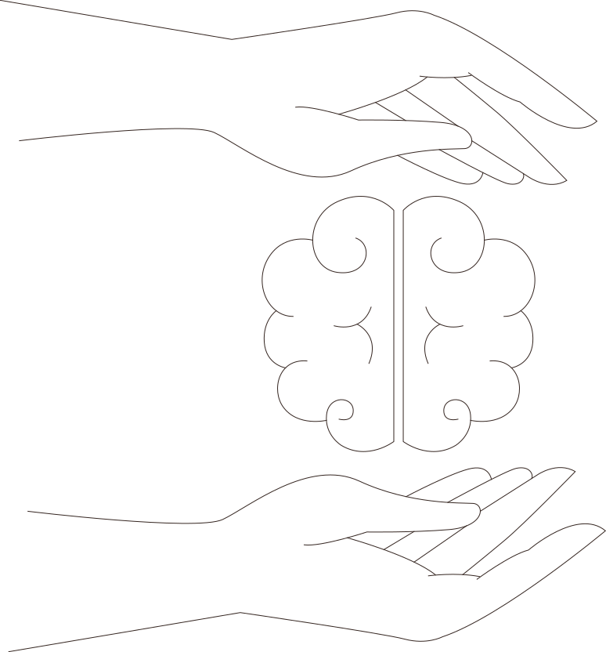


Thank You!

